Slide 1

From Fear to Finesse:
Helping Students Navigate Bumps on the Road to Academic Success.
‘Tell me and I forget.
Teach me and I remember.
Involve me and I learn.’
Benjamin Franklin
Dr Kevin Watson
Head of Upgrade

Slide 2
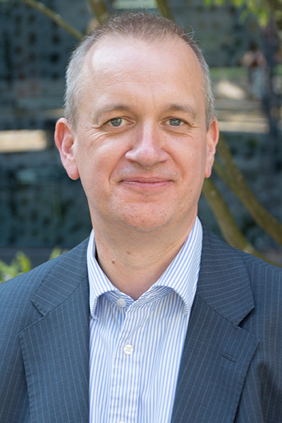
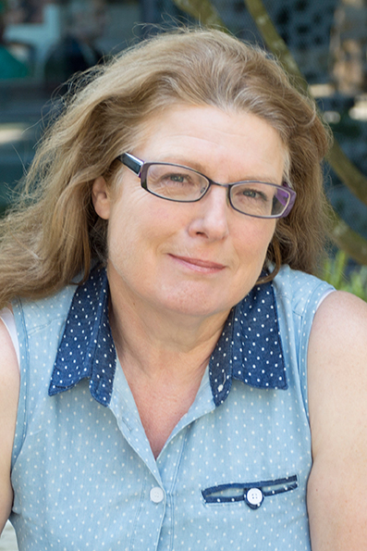
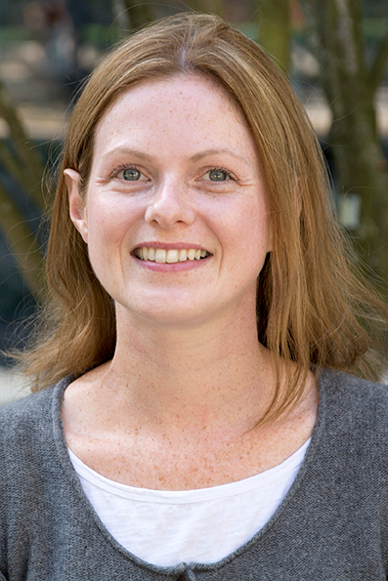
Upgrade
Kevin Watson
Head of Upgrade
HSS Faculty Contact
BUS Faculty Contact
Janet Godwin
SpLD Specialist
HLS Faculty Contact
Catrin Radcliffe
Maths & Stats Specialist
TDE Faculty Contact
Notes:
Upgrade is the university’s study skills department. We offer online resources, group teaching sessions in academic departments, and the core work of one-to-one appointments.

Slide 3
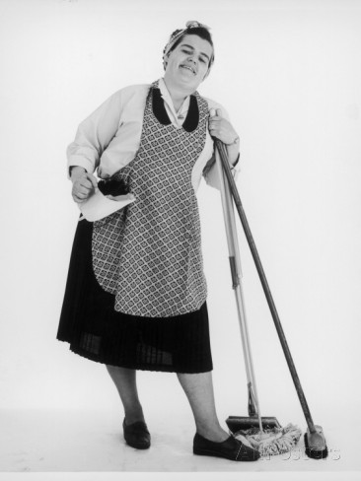
Does study skills look like this?
Mrs Mop
Mopping up worries and fears 
Performing an essential role 
Being seen as having low status 
Clearing up the mess 
Dealing with the individual mess of students 
Feeding on demand 
Being invisible 
Having a gendered, caring role 
Acting as disinfectant for academic failure
(Bishop, Bowman & Finnigan, 2009)
Notes:
This is very much how study skills departments tended to be a few years ago. As someone once said to me at another university, ‘Why do we need a department like yours? Surely we could do the same thing with a final year student who knows how to write an essay.’ It seems to me there’s a whole lot wrong with this. It’s passive, it’s very much a one way street; it doesn’t take account of joined up solutions to problems and probably would only appeal to some students.

Slide 4

Or this?
Magician
Laying on of hands 
Implying the person you are working with is passive 
Being linked to power relations 
Carving out space and students and staff feel as if a miracle has taken place 
Being introduced to students as the miracle worker
(Bishop, Bowman & Finnigan, 2009)
Notes:
Clearly this is the nearest to right! I would particularly draw attention to the ability of study skills practitioners to stand apart from the power relations that tend to exist between tutors and students. We do sometimes see students coming to Upgrade and seeing remarkable results (e.g from marks averaging in the 50s one semester to the 70s in the next) but then most academics have repeatedly had that experience of the student who finally gets it in the last year and wishes they’d been so into it all earlier. Where we see dramatic results, it is usually because the student has found their own confident path forward – they may have come to Upgrade and developed the ability to ask more questions, leading to moere conversations with tutors and other students, more reflection on their way forward and ultimately better results. We are not miracle workers but that is at least partly because:

Slide 5

Upgrade works most effectively through collaboration

Slide 6

Guiding Principle 1:
How to study effectively is not obvious.
Notes:
Many students are embarrassed about talking through their study habits because they feel their presence at university carries the assumption that they know what they are doing. We start from the assumption that nothing is obvious, that basic questions like how to read, plan or use basic maths are worth revisiting because old habits often need revising or reforming for success at HE level.

Slide 7

How do you know when you have read something?

Slide 8
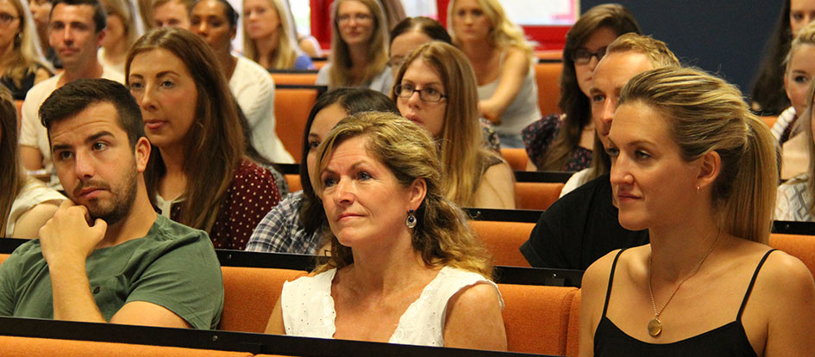
Upgrade Guiding Principle 2:
Academic success is not just about ways of doing, but ways of being.

Slide 9
“Why do I have to do all this reading just to teach literacy?”
“Why are you asking me what I think? You’re the teacher.”
“You can’t ask us that. It wasn’t covered in the lectures.”
“I’m not an academic.”
Feedback

Slide 10
Why do students struggle academically?
Doing (skills)
Being (qualities)

Slide 11
Lea & Street’s Overlapping
Academic Literacies (1998)
Study Skills
Defining problems as technical, cognitive and transferable to different settings.
Academic Socialization
Acculturation into discourses, genres and institutional expectations. Often involves some degree of imitation.
Academic Literacies
Similar in many ways to the academic socialization model, except that it views the processes involved in acquiring appropriate and effective uses of literacy as more complex, dynamic, nuanced, situated, and involving both epistemological issues and social processes, including power relations among people, institutions, and social identities.

Slide 12
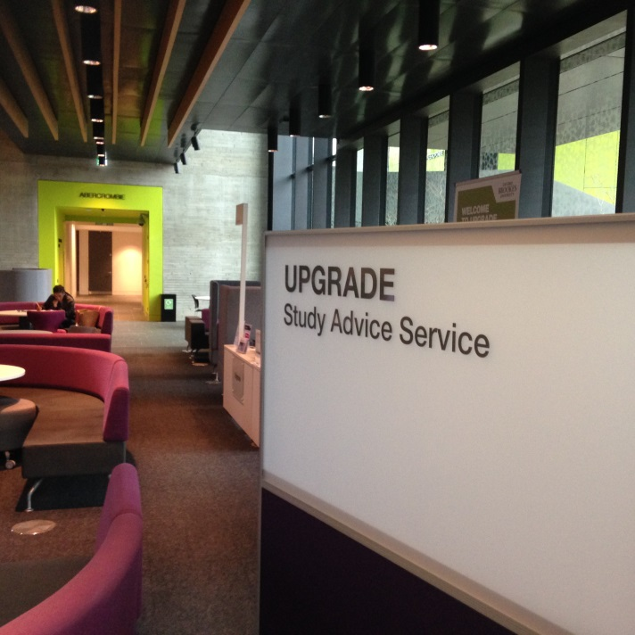
Upgrade Guiding Principle 3:
Start where the student is…
30 minutes to deadline / can’t get started / referencing is a mystery / working out how to be critical / can’t understand assignment instructions / planning….
Motivated / not motivated / nervous / over-confident / under-confident / uninterested / perfectionist / taking criticism personally / annoyed / frustrated / not motivated….
Notes:
We do that partly through physical location; we do it also by working with academic staff to build study skills into module content, normalising it as something to think about. What do we assume that students know that maybe they don’t know. Our maths tutor, Cat Radcliffe, and the issue of hidden maths. My own experience of moving from lecturing in history to study skills demonstrated to me that I had assumed a great deal

Slide 13
Upgrade Guiding Principle 4:
Show, not tell
'Everyone in the sample group is female. Nobody in the group can swim. It is apparent that women cannot swim.‘

Slide 14
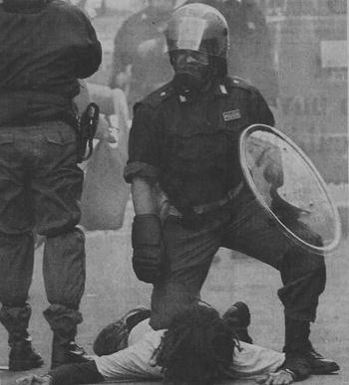
Upgrade Guiding Principle 4:
Show, not tell

Slide 15
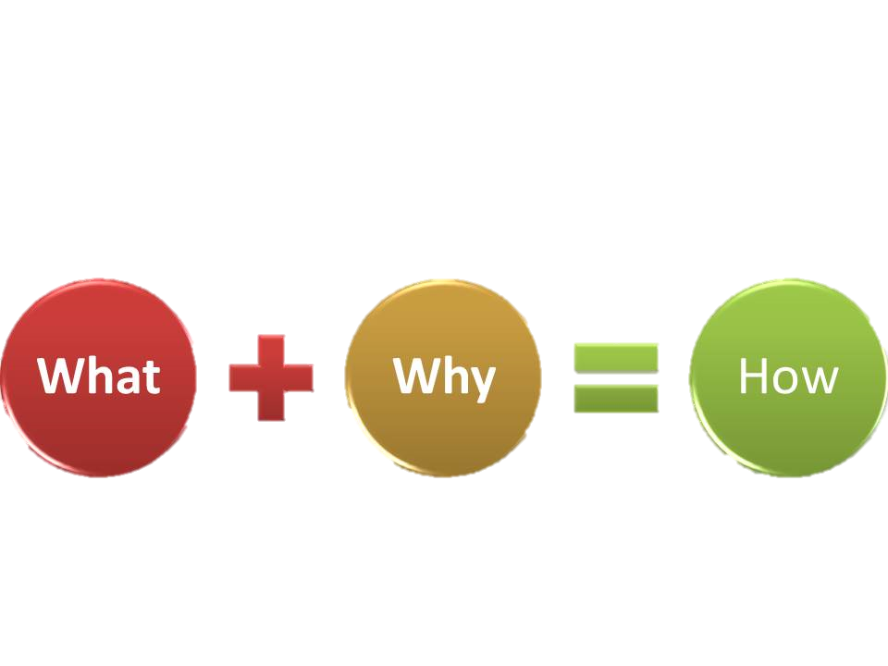
Upgrade Guiding Principle 5:
What + why = how
Notes:
On the one hand I talk to academic staff who don’t understand why their students struggle with referencing and on the other hand I meet students who get incredibly worried about whether they have put all their commas and full-stops in the right place. When teaching referencing we have to get to the logic of it; why it is the way it is and that invariably means a broad view of what we mean when we say referencing – more often than not confusion about formatting is also linked to a lack of confidence on how to decide what to read, how to read critically, synthesise and so on.

Slide 16
References
Bishop, C., Bowmaker, C., & Finnigan, T.J. (2009) Mrs Mop, mechanic and /or miracle worker: Metaphors of study support, Journal of Learning Support in Higher Education, 1. Available at: http://www.aldinhe.ac.uk/journal.html (Accessed 10 November 2014)
Lea, M. & Street, B (2009), ‘Student writing in higher education: An academic literacies approach’ in Fletcher-Campbell, F., Solver, J. and Reid, G. (eds), Approaching Difficulties in Literacy Development: Assessment, Pedagogy and Programmes. London: Sage, pp. 260-276.

