Slide 1
Peer mentoring in disciplinary focused transition: A partnership approach
Children’s Nursing Team
Julia Winter 2017
Notes:
JW

Slide 2
Project question ….
Can academic and professional transition in pre-registration children's nursing students be supported through focused peer learning activities?
Explore by:
•Evaluating the impact of peer led academic interventions designed to support disciplinary focused academic self-efficacy and professional "becoming“
•Review whether the role of peer mentor supports the development of professional and academic self-efficacy
Aim to:
Contribute to the body of knowledge on the meaning of "becoming" as a part of transition

Slide 3
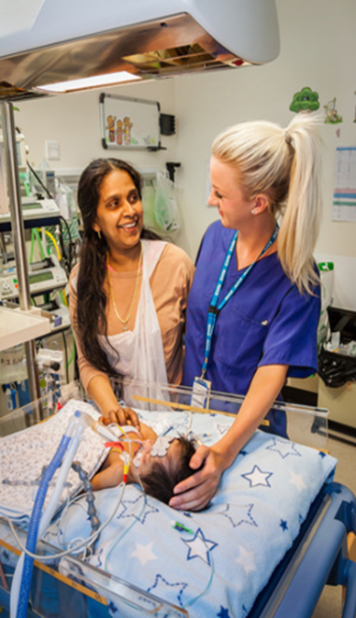

Slide 4
So ……
Notes:
The concept of becoming derives from the work of Gale and Parker ..
, Gale and Parker writing in 2012, suggest that the concept of transition is “under theorised” despite there being a significant body of literature around transition as an educational process. Referencing to literature reviews from the UK, Australia and the USA, Gale and Parker propose that transition activities can be conceptualised as induction – pertaining to institutional requirements and expectations ; development – pertaining to the development of an HE identify and becoming – a concept yet to be understood in research and practice. However, becoming is a concept which is arguably of specific significance in the preparation for professional roles in health and social care and potentially as Gale and Parker suggest , is mindful and orientated towards student difference and therefore inclusivity.
So we need to identify and help students identify their own academic skills orientation and differences , to help support them in the becoming for their own discipline

Slide 5
However transition can be hindered by
“academic self handicapping -
self imposed defence mechanisms
& to development
In PG students evidence that previous academic
reference points be come invalid- which is unsettling
More resilient students overcome
Notes:
The development of sense of self in terms of becoming for students as prospective health care or social care professionals seems to have two key attributes, namely academic and professional. These are not mutually exclusive and arguably should be symbiotic. Common to health and social care professionals is the working context of dynamic and challenging situations, where the client and patient outcomes are reliant on the competence of the professional agent . The ability to cope and respond in such challenging contexts requires professional resilience and self-efficacy. Self-efficacy as an academic attribute is described by Chemers (2001 ) as requiring the development of persistence and problem solving skills which in turn promotes the ability to deal with disorder. There are parallels here with Benner’s (1984) seminal work on the concept of “Novice to Expert”, where through situated learning, the practitioner develops skills to analyse and manage situations rapidly, reinterpreting previously held schema to problem solve.
The potential for self-efficacy both academic and professional arguably initially requires a degree of self-awareness and Thomas and Gadbois (2007) describe the problems created when students engage in academic self-handicapping which whilst it can offer a degree of protection from unexpected criticism, can also limit individual potential if students persist in un challenged beliefs about their own areas of limitation. Early interventions to explore this aspect of transitional development seem therefore to be supported.

Slide 6
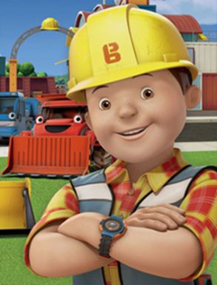
Needed to identify how we could build
interventions to “fix it “
Literature suggests that transition
is better when peer supported – (build on
existing buddy system)
Plus envisage potential to grow graduate
professional skills through supporting
Juniors colleagues.
Notes:
When considering the findings of Scott et al (2011) and transition from pure to applied discipline, students expressed concern re assessing their own progress, so lacked self-efficacy.
We had an existing buddy system – (set up about 5 years ago). This was set up with the aim of implementing peer support, something that the students had expressed a need for. The buddy system formally places students into triads of 1st, 2nd and 3rd years (and now 4th years). When 1st years start we allocate them a 2nd year buddy who will be studying same course and usually placed in same placement area. They are then supported by the 2nd year and the 2nd year’s buddy. Up until this point this system enabled the groups to meet 2 – 3 times a year over lunch and gave them the opportunity to offer support and encouragement to each other.
Evaluations of this system demonstrated that it was received very positively by students but that they wanted it to be developed. The system also reflected our teaching philosophy of working in partnership with students and allowing them to work in partnership with each other. (which mirror partnership philosophy of children’s nursing so this system enables us to role model this philosophy).
This system also allows students to develop nursing skills eg communication and supporting junior colleagues (NMC requirement).

Slide 7
After some consideration agreed on four within curriculum peer interventions:
Teacher supported self assessment of Habits of Mind
Peer supported reflective writing
Peer Supported literature searching
Peer supported using a problem based learning model

Slide 8
Activities:
1.Teacher led :
Identifying “habit of mind” – prevent academic self handicapping
….. Diagnostic
Notes:
Habits of mind self assessment – was the first strategy used to help students gain insights into their own abilities , and move them away from self handicapping
The ability to achieve the resilience and problem solving abilities needed as a health care professional we felt centred on the ability reflect to understand, think creatively and problem solve , and adopt an evidence based approach to care .
Reflection and PBL were already integral to the curriculum , ( as is EBP) . But we noted a lack of confidence in the ability of students to use well. Reflective writing especially challenging for PG science students .

Slide 9
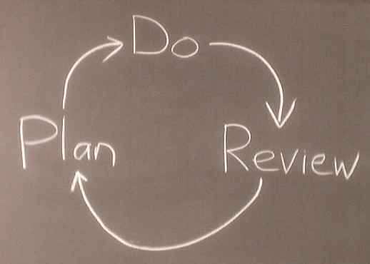
Peer led activities
1.Developing reflective writing skills - Focus on practice reflection (early Sem 2)
Prepared senior students by modelling a simple teaching Cycle –
Double intent –
Support assignment prep (motivation)
Peer support to first years to develop reflective writing
We prepared resources (in partnership with senior student )
Notes:
The first peer supported intervention we developed was making better use of structured reflection . Adopting a senior peer learning support model was closely linked the concept of extended transition and “Becoming”.
The significance of interpersonal and social aspects in supporting effective transition into University life are well described (Knight and Rochon 2012, Thomas 2012 ) but in pre-registration health care programmes there is an additional significant element to transition in that students also have to learn and self-establish a specific professional identity. Thomas (2012) identifies the need for proactive engagement to develop in students a sense of fit. Observation and experience tells us that junior students will orientate themselves to senior students in practice settings and current intra year buddy systems have been well received by health care students particularly as an aid to learning how to cope with and behave in practice settings.
By linking the peer activities to aspects of the senior students curriculum and assessment , they also reinforced their own capabilities . Eg reflection and a reflective essay ..
So we prepped the second years ( as per the slide above ) . Activities were opt out not opt in .. Linked to NMC standards around supporting junior colleagues . Buddy system also allows students to develop nursing skills eg communication and supporting junior colleagues (NMC requirement).
Ask for thoughts on what happened …
Invite thoughts first – how did it go ?
Ans: the second years seemed to tackle
with enthusiasm
Staff on hand to trouble shoot – few minor Q’s
First years worked with second years seemingly
happily – brought examples of their own
reflective writing for feedback
The experiences then explored through
focus groups – facilitated external to team
Generally positive but the unexpected findings:
Some first years queried the expertise
Some second years confessed to lack of confidence
Concerns that reflective writing was a challenge and not in the experience of previous study
Other useful feedback re lit searching and PBL – plus the value of the buddy system per se . (role model, inspire to succeed , “safe” support )

Slide 10
Literature Searching (mid Sem 2)
Supporting evidence based thinking
Senior buddies completing dissertations
1:1 step by step with first year junior buddy
Assessment relevant topic

Slide 11
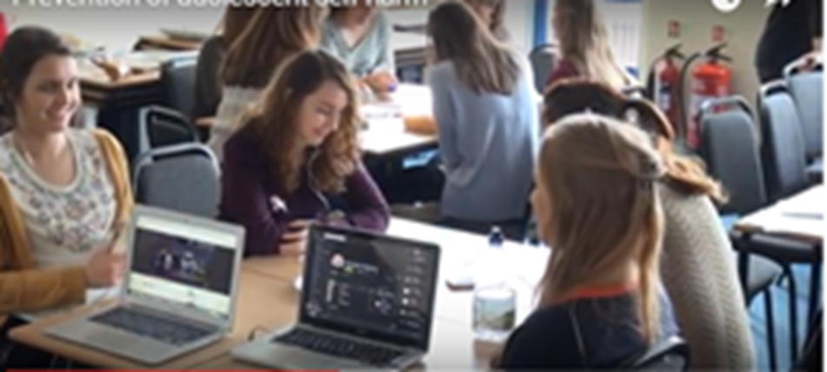
Problem based learning (late Sem 2)
Third years with junior buddies
Linking reflection to problem solving
Sharing pitfalls of own experiences of PBL groups

Slide 12
Partnership … from focus group reviews – further developments planned and we changed:
Reviewed reflection materials with students – they suggested minor edits such as writing SMART goals as the last stage of reflection which students find challenging
From the focus groups – shared with the next set of senior of students as part of their preparation:
Confidence - Explained to first years why they could trust seniors to teach them !
1:1 literature searching with assignment focus valued – but want earlier
Problem based learning – a challenge
Informal curriculum is very important –
Reorganising placements to support time together in practice
Notes:
Evaluated first year perceptions through focus groups , plus also monitoring marks and quality of reflective writing …

Slide 13
Work in progress , but so far proving positive - we have seen improvement in grades and writing skills
NSS up to 100% for last 2 years
Strong sense of cohort cohesion and identity
Big piece of work to do in partnership with students on looking at validity of the assessment of Habit of mind and then on developing individual activities to address gaps in Habit of Mind
Notes:
JW

Slide 14
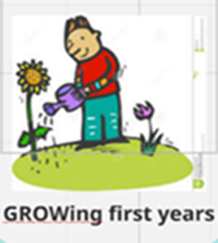
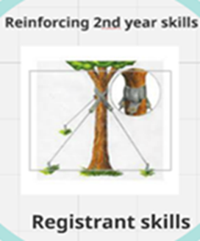
Peer mentoring aimed to GROW
and
Scaffold
and
Support professional transition
and becoming…..

Slide 15
Summary

Slide 16
Sources:
Benner, P. (1984). From Novice to Expert, Excellence and Power in Clinical Nursing Practice. Menlo Park, CA: Addison-Wesley Publishing Company.
Chemers, M. Hu, L. and Garcia,B. (2001) Academic Self-Efficacy and First-Year College Student Performance and Adjustment Journal of Educational Psychology
93,1, 55-64
Costa, A.L. (2000) Describing Habits of Mind (Chapter 2) in A.L. Costa and B. Kallick (eds.) Discovering and Exploring Habits of Mind. A Developmental Series, Book 1, Association for Supervision and Curriculum Development, 1703 North Beauregard Street, Alexandria, VA. Available at: http://www.ascd.org/publications/books/108008/chapters/Describing-the-Habits-of-Mind.asp, accessed August 2016.
Costa, A.L. and Kallick, B. (eds.) (2000) Discovering and Exploring Habits of Mind. A Developmental Series, Book 1, Association for Supervision and Curriculum Development, 1703 North Beauregard Street, Alexandria, VA. Available at: http://www.ascd.org/publications/books/108008/chapters/Describing-the-Habits-of-Mind.asp, accessed August 2016.

Slide 17
Costa, A.L. and Kallick, B. (eds.) (2008) Learning and Leading with Habits of Mind: 16 Essential Characteristics for Success, Association for Supervision and Curriculum Development (ASCD).
Dewey, J. (1922) Human Nature and Conduct New York , Henry Holt and Company. available at : https://archive.org/stream/humannatureandco011182mbp/humannatureandco011182mbp_djvu.tJtx July 2016
Gale, T., and S. Parker. (2011) Student transition into higher education. ALTC Good Practice
Report. Surry Hills, NSW: Australian Learning and Teaching Council. Available at:http://fyhe.com.au/wp-content/uploads/2012/10/Student-transition-into-higher-education.-ALTC-Good-practice-report.-Gale-T-Parker-S-Deakin-1.pdf accessed July 2016
Scott, D. Evans ,C. Watson, D. Hughes,G. Burke, PJ, Walter,C. Stiasny, M. Bentham, M. and Huttly,S. (2011) Facilitating Transitions to Masters- Level Learning - Improving Formative Assessment and Feedback Processes NTFS Projects Final Report HEA
Thomas, C. and Gadbois,S. (2007) Academic self-handicapping: The role of self-concept clarity and students’ learning strategies British Journal of Educational Psychology, 77, 101–119.

