Slide 1


Slide 2
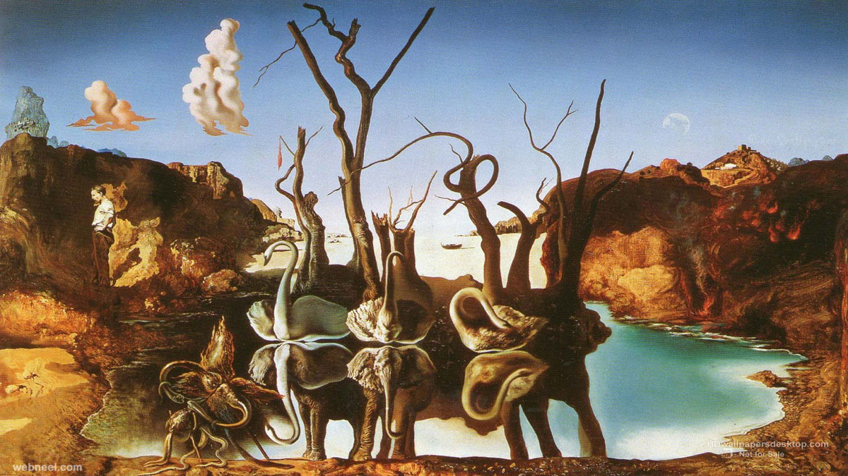

Slide 3
Context and approach
Why are we doing these sessions?
  Yes, our attainment gap for BME students
  Opportunity to talk about the importance of inclusive practice in a wider sense
What’s our focus?
  The individual, the student perspective
  Mostly, but not exclusively, BME and international students
  Looking at what we can do to be more inclusive
    initiatives from other HEIs
    tips at a more practical, lecturer/tutor level

Slide 4
Examples of sector diversity issues
BME attainment (there is a link, in part, to international student attainment)
Diversity of curriculum
Changes to Disabled Students Allowance
Gender equality vs(?) male attainment?
LGBTQ representation/retention

Slide 5
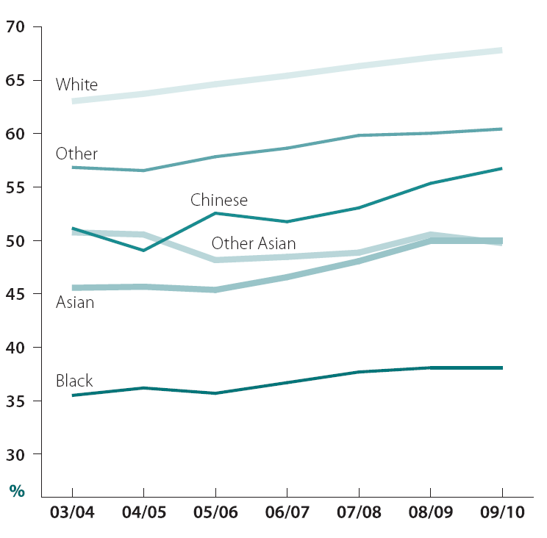
Sector wide first degree undergraduate qualifiers obtaining a first or upper second class honours degree by academic year and ethnic group
Source: ECU Statistical Report 2011
Notes:
ECU attainment data

Slide 6
Who is in our classroom?
 | England | Faculty
Disability / dyslexia | 10.1% | 11%
Different cultural backgrounds (e.g. BME / international) | 23.2% (UK BME) 38.7% of Bus students are international | 19.1% (UK BME) 29% Int (+ 10% EU)
LGBT | 6%€ | Unknown
Mature students | 44.6% (over 21) | 37%
Gender | 56.1% (female) | 49%
€ limited data collected

Slide 7
Who is in our classroom?
 | England | Faculty | UG | Masters
Disability / dyslexia | 10.1% | 10% | 13% | 5%
Different cultural backgrounds (e.g. BME / international) | 23.2% (UK BME) 38.7% of Bus students are international | 26 % (BME) 29% Int (+ 10% EU) | 22% (BME) 24% Int (+10% EU) | 28% (BME) 55% Int + 12% EU)
LGBT | 6%€ | Unknown | Unknown | Unknown
Mature students | 44.6% (over 21) | 37% | 14%
Gender | 56.1% (female) | 49% | 47% | 64%
€ limited data collected

Slide 8
Attainment gaps across groups
 | England | Faculty
Disability / dyslexia | -1.2% (varies by disability)
BME | -16% (varies by ethnicity) | -19% to -9% (UG) -52% (PG)
International | Unknown (anecdotally lower than UK) | -33% (UG) -44% (PG)
Gender (female) | +5.1% (varies by subject)
Mature Students (over 21) | -13.3% | -18.4%
Percentage gap based on good completion (1st / 2.1)

Slide 9
Case study - Derby
https://uodpress.wordpress.com
BME attainment gap fallen from 24% to 14% in three years (likely to continue falling to around 12% in the latest reporting year.)
Taken an inclusive approach which focuses on small interventions, e.g. assignment checklist, increasing student confidence, professionalism in the classrooms

Slide 10
Key topics for change
Group work / group mixing / composition
In class isolation
Perceived disengagement
Our confidence in dealing with difficult topics, e.g. Race, sexual identity
Curriculum bias
‘Seeing myself in the classroom.’
‘Role models’

Slide 11
Induction / transition
Acknowledging prior educational experience
Making explicit the ‘Brookes HE experience’
Managing Expectations

Slide 12
Case Study- Bradford
Trans:it- Supporting students transition from FE to HE
6 topics
  You and Higher Education
  The Independent Learner
  Time Management
  Managing Information
  Writing for Higher Education
  Group Work
Notes:
http://www.bradford.ac.uk/transit/using-transit/
Mature students

Slide 13
Case Study Cont.
Barriers highlighted by students:
  External Commitments
  Paid Work
  Time Management
  Lack of information
  Belonging
  Support

Slide 14
Understanding the issues – Marginality, Belonging & Mattering
Although there has been a focus on participation & attainment the research suggests that issues of engagement and belonging are key to the whole student experience including attainment.
Notes:
‘I get that a lot, like people saying “oh is this thing racist, is this thing racist?” And it’s like “well for a start I’m not here to educate you but also you should be able to work it out for yourself.’ (Brookes Student)
“I have to prove myself in terms of, you know, making sure that everything I do is a 110 plus, not just 100% because there’s always someone who looks at you as being black and with an accent, they always look at you like you’re stupid” (Brookes student from Kenya)
“I need to ask these lecturers because I could have a baby right now, what implication will this have on my course and all I met was just really, you know, like barriers, constantly because I remember one of the lecturers he say to me, oh if I knew you were that pregnant I would not allow you on the course.” (Brookes Student)
“Even though I found I had a culture shock when I came living here. My foundation course made it easier for me because they explained to your that you might have that. I had a teacher in foundation, if he feels you are always on your own, he will ask you why. He will go and get some people from your country and introduce you to somebody and say ‘look this person is from your country.” So that you feel more socialising with people. It was a fantastic experience.” (Brookes student from Nigeria)

Slide 15
“I have to prove myself in terms of, you know, making sure that everything I do is a 110 plus, not just 100% because there’s always someone who looks at you as being black and with an accent, they always look at you like you’re stupid” (Brookes student from Kenya)
“I need to ask these lecturers because I could have a baby right now, what implication will this have on my course and all I met was just really, you know, like barriers, constantly because I remember one of the lecturers he say to me, oh if I knew you were that pregnant I would not allow you on the course.” (Brookes Student)

Slide 16
Students
“Certain universities are not that inviting. They are not that accessible when it comes to grades and not really properly advertised to Black students. So Black students think that they’re not really good enough. It’s not for them.”
NUS 2011

Slide 17
“It was very hard to transition at uni because I was confused about where I was going and I failed my first attempt at my first year because I was so anxious about being misgendered and ‘found out’. I couldn't pay attention in lectures and often got as far as the classroom door only to have a panic attack and have to go home…
Trans respondent NUS 2015
Notes:
Recommendation: Include LGBT perspectives and authors in curricula and raise students’ awareness on equality and diversity issues to prevent ignorant or offensive comments in social or teaching spaces.

Slide 18
academic skills development
Criticality
Reflection
Learner autonomy / independence
Assessments and assessment type

Slide 19
Early Intervention
Indicators of ‘at risk’ students, e.g. attendance, formative assessments, early summative assessments.

Slide 20
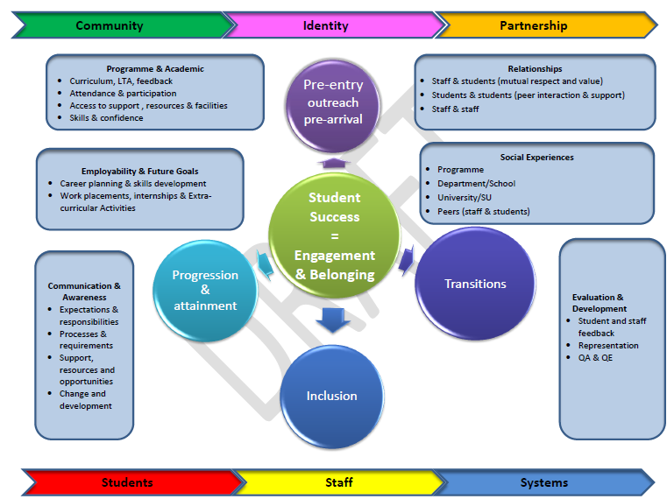
To summarise….

Slide 21
Summary
Inform and educate ourselves
  be aware of our own identity and assumptions, and how they impact on our practice
  Build a climate of trust and respect (from the start)…links back to induction and orientation
Know our students as much as we can
  do we always get the chance?

