Slide 1



Identifying Best Practice in Academic Induction
Foundations for Academic Success
Orientation, Transition and Integration
Jacqui O’Rourke
Senior lecturer
Subject Coordinator BK & KM

Slide 2

Session Structure
The Context – Programme Philosophy
The Module in Practice
Outcomes
Questions

Slide 3
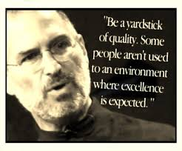
What are the Foundations for Academic Success ?

Slide 4
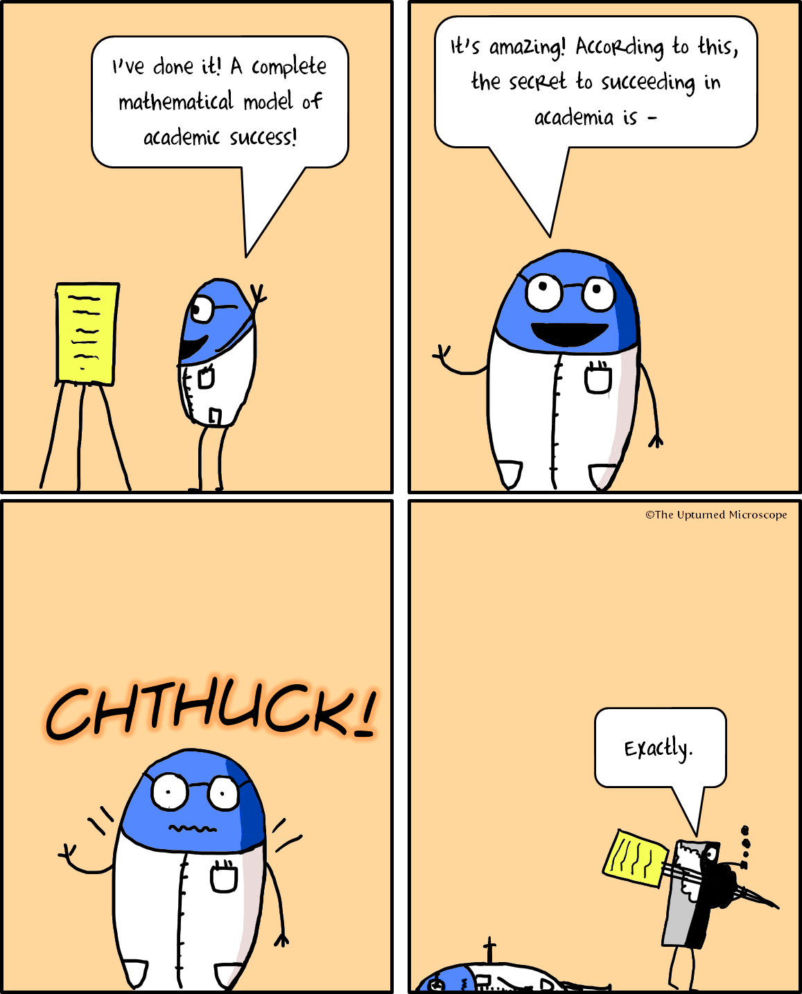
U55001 FAS
F0undations for Academic Success
.

Slide 5
The Programme Philosophy
Enquiry-Based Learning (EBL), with a strong vocational focus.
Module design based on traditional university values of engagement with conceptual and theoretical thinking.
Critical inquiry blended with practical insights.
Engage with and apply business and marketing theory in a critical and professional manner.
Build students’ knowledge, expertise and skills, and lead them towards tackling increasingly fuzzy and complex problem-solving scenarios integrating different areas of study.
Encouraged to develop independent thinking, and improve their interpersonal skills.
Move from dependent to independent learning, as part of a seamless, continuous process, becoming more autonomous learners in their final year.

Slide 6
U55001
Foundations for Academic Success (FAS)
Acts as an induction to the culture and philosophy of the programme
Seeks to develop the skills to allow the student to flourish in that environment.
Through the lens of real business and marketing problems, students will acquire the necessary research, critical analysis and communication skills
Students are given the opportunity to develop their skills in specific areas, based on individualised tutor feedback.
Extended orientation process introduces students to the value and concepts of Personal Development Planning (PDP), essential for continued professional development and preparation for life-long learning.

Slide 7
BA(Hons)
Business & Marketing Management – BK
Marketing Management - KM
Level 4 (Year 1)
Semester 1 | Semester 2
U55001 Foundations for Academic Success (double)
U55003 Marketing in Context (double) | U55005 Marketing Research (single)
 | U50007 Accounting and Financial Information (single)
U51002 Foundations of Business (or S2) | U58003 Planning a Successful Event
Notes:
Explain Stage 1 – students need to pass 8 modules but can progress to stage 2 once they have passed 6 modules. Level 4 is the new way of describing what used to be known as basic modules

Slide 8
U55001 Foundations for Academic Success (FAS) – The Philosophy
You do not learn unless you are having fun
Emphasis is on developing academic skills taught through a range of activities
Enjoyable and Challenging

Slide 9
Module Pillars
F
A
S
FLEXIBILITY
FEEDBACK
FUN
FUTURE
ASSESSMENT
ACADEMIC CONDUCT
SKILLS
SUPPORT
STAFF

Slide 10

SKILLS
Information Searching
Writing University Assignments
Referencing
Solving Business Problems
Presentation
Managing Group work
Engaging with Feedback
Examination techniques
Employability Skills

Slide 11

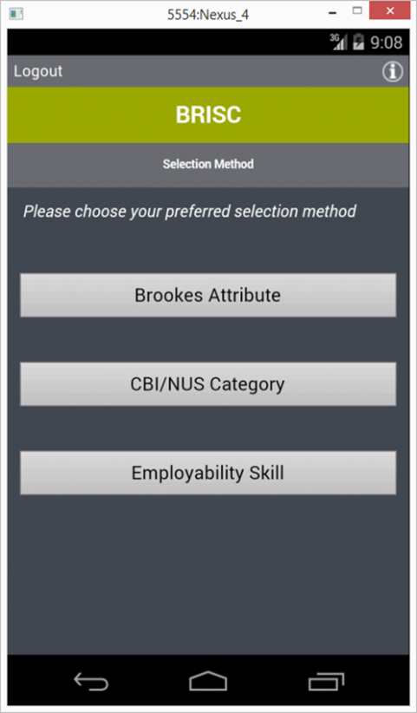


Employability
BRISC
BRookes Individual Skills Catcher
Capture all those employability skills you pick up on your Brookes travels ☺

Slide 12

Develop a Linkedin profile
Linkedin Competition
Final assignment based on skills in Linkedin profile

Slide 13
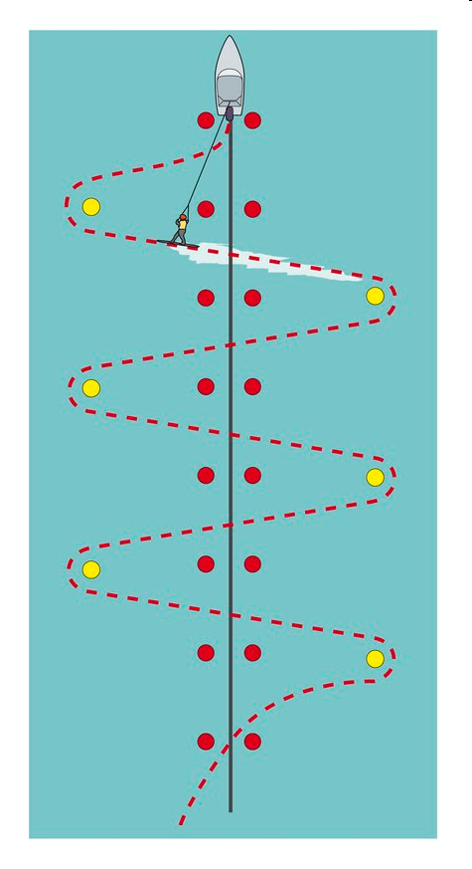

Support
Foundations of Academic Success | Semester 1 Marketing in Context Semester 2 Marketing Research
Wk 1….. Wk 2….. Wk 3….. Wk 4….. Wk 5….. Wk 6….. Etc….. | Wk 1….. Wk 2….. Wk 3….. Wk 4….. Wk 5….. Wk 6….. Etc…..
Stage II modules

Slide 14


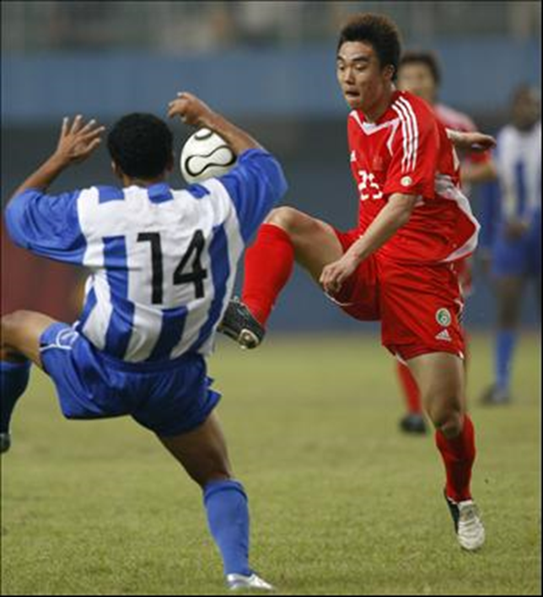
INDUCTION WEEK
3 Steps to Academic Success
STEP 1
Read lots of books and journals
STEP 2
Show us what you now know
State where all of the information
has come from
Know the rules of the game –
know how to reference
STEP 3
`

Slide 15
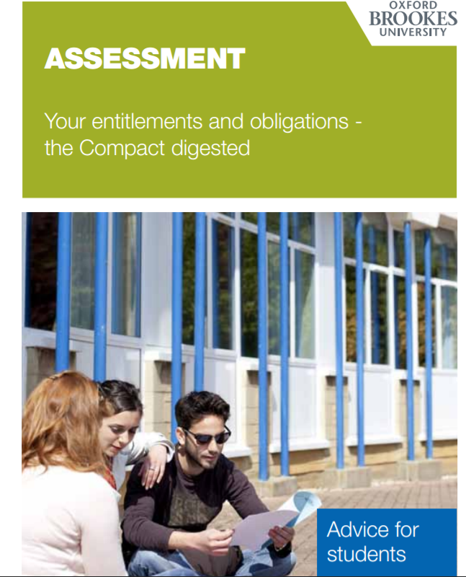
Assessment
Assessment for learning.
Assessment is central to the curriculum, and there should be no distinct boundary between assessment,
teaching and learning.

Slide 16
Assessment
Semester 1
Assignment 1 Individual Essay 1000 words 15%
Assignment 2 Individual Essay 1250 words 20%
Semester 2
Assignment 3 Group Advertisement 20%
Assignment 4 Individual Report 2000 words 30%
Assignment 5 Individual Reflective 3 minute audio clip 15%

Slide 17



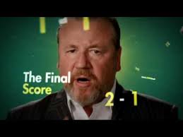
Assessment
Semester 1
Assignment 1 – submitted in week 4 Returned in week 6
Individual face to face feedback week 7
Do advertisements have to tell the truth?
Do celebrity endorsements work?
Is Heineken a suitable sponsor for the Rugby World Cup?
Should betting advertisements during televised sport be banned?

Slide 18
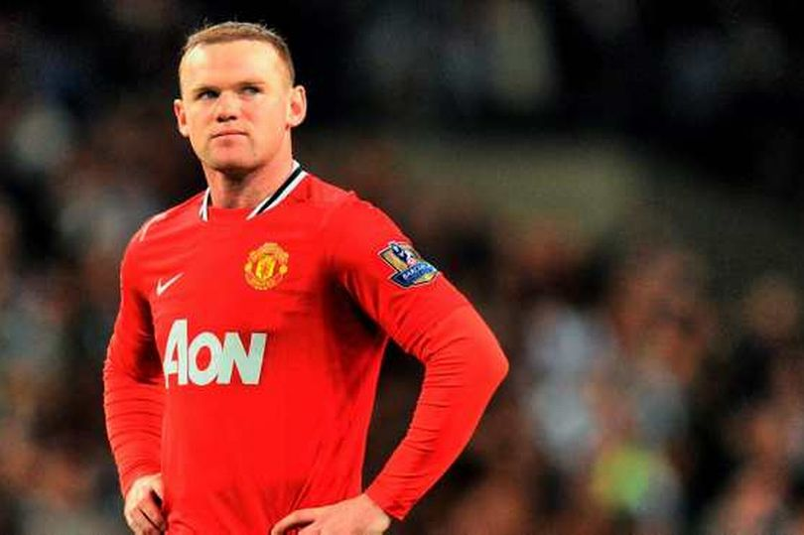



Assignment 2
Draft through Turnitin – Monday week 8
Discussion of Turnitin report in class Monday week 8
Final version Friday week 8
Returned in Week 11 Week 12 Feedback surgery
How should celebrity tweets be regulated?”
Should toy companies promote gender equality?
“”
Why do companies use sexist advertising?
Does gender stereotyping in advertising matter?
Unilever vows to stamp out female stereotyping in its adverts

Slide 19

Academic Conduct
Referencing
- EndNote
Turnitin
Duplication, Collusion, Collaboration etc

Slide 20
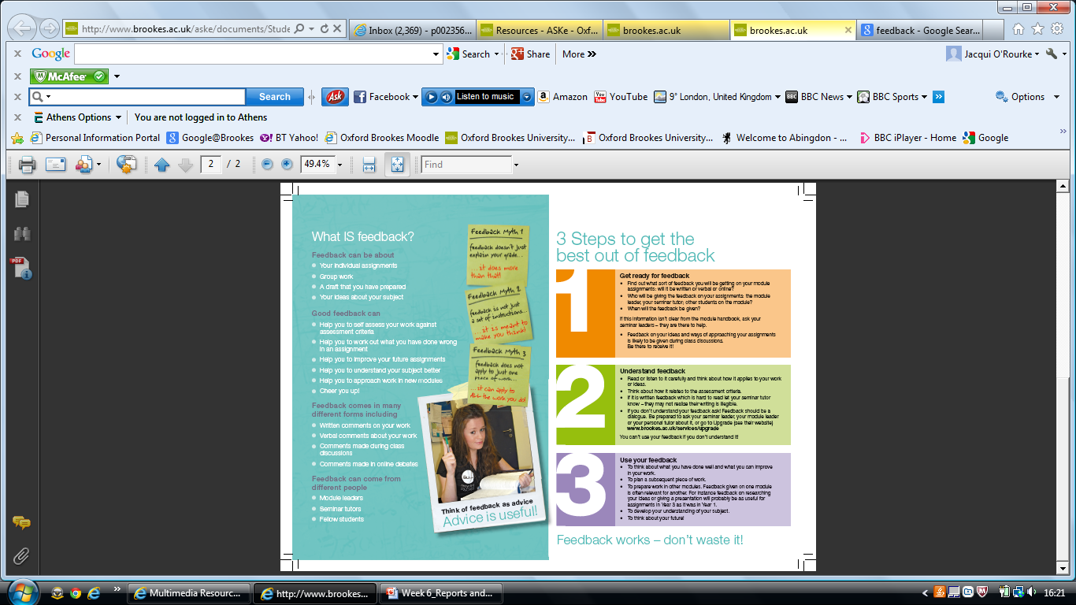
Making the Most of Feedback

Slide 21
Feedback
Assignments 1, 2, + 4 hard copies returned in class
Actions plans worked on in class based on feedback
Semester 1
Week 7 Individual 1 to 1 tutorials
Week 12 Feedback surgery
Semester 2
Written Feedback on draft of Assignment 4
Week 11 Feedback surgery
Semester 1 Year 2
Generic feedback on assignment 5 in U55040

Slide 22
Semester 1 Summary
Transition to University Life
3 Steps to Academic Success
Skills Development
Feedback for Feed Forward
Support U55003 Marketing in Context

Slide 23

Semester 2
Consolidate and further develop skills
Consolidate marketing knowledge
Support U55005 Marketing Research
Transition to Stage 2

Slide 24
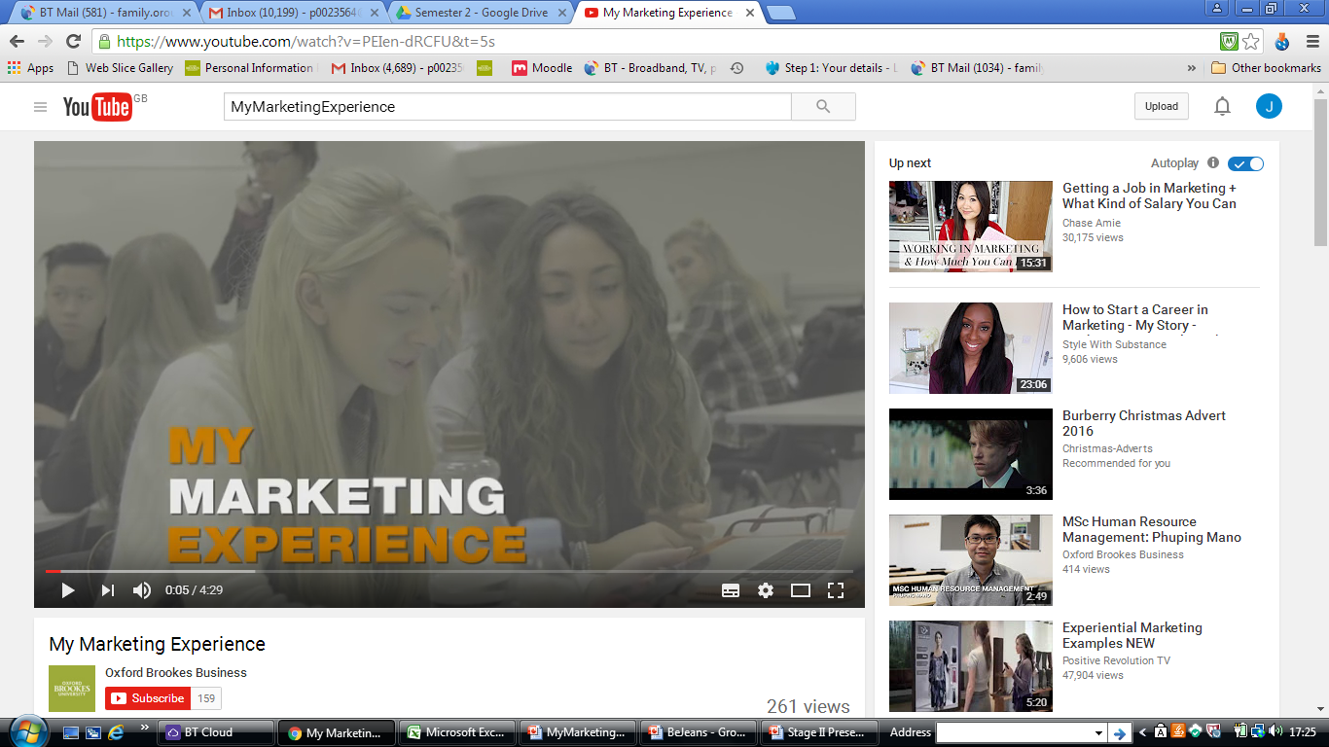
Assessment

Slide 25
Assessment
Assignment 3 Team Advertisement 20%
Working in your team you must produce an advertisement, for your simulation product, suitable for use in a magazine or on a billboard
Assignment 4 Individual Report 2000 words 30%
Using the theories discussed on the module and your own reading you should evaluate your own performance and how well your group worked as a team during the simulation. In order to do this you should first provide a brief overview of how your team was organised and how decisions were made before using theory to evaluate how the team functioned before making recommendations as to how the team performance could be improved
Assignment 5 Individual Reflective 3 minute audio clip
Develop a skills profile suitable to be posted on LinkedIn and provide a 3 minute reflective audio file reflecting how you developed the skills included in the profile

Slide 26
Future
Stage 2 choices guidance - 2nd and final year students
Transition to level 5 - guidance from current 2nd years
Explicit links to FAS and skills development in U55040 (compulsory 2nd year double)

Slide 27
Staffing
Small team
Links to other modules
Link to 2nd year

Slide 28
FEEDBACK VERY GOOD FEEDBACK ON WORK
How prompt feedback was for assignments
FUN I really liked the mymarketingexperience as it was fun. I really enjoyed taking this module!
FUTURE I acquired many employability skills. LinkedIn challenge very good
ASSESSMENT Poster, audio file and report meant there were varied methods of grading on module which suited a variety of needs.
How varied each assignment was
SKILLS It involve independent learning. Taught so many useful things. It was really helpful at helping me develop my academic qualities and knowing what to expect in assignments
Really aided my learning
SUPPORT Interaction with lecturers was extremely valuable. I felt constantly supported throughout the course. If you needed help with other modules it could be given in FAS
STAFF Staff were the best staff I have had all year- really enthusiastic and very encouraging.
F
A
S

Slide 29
Identifying Best Practice in Academic Induction
Foundations for Academic Success
Support from Induction to Stage 2

Slide 30

Questions

